Slide 1
DIATECH Market & Sales Deck
Pre-filled Version

Slide 2
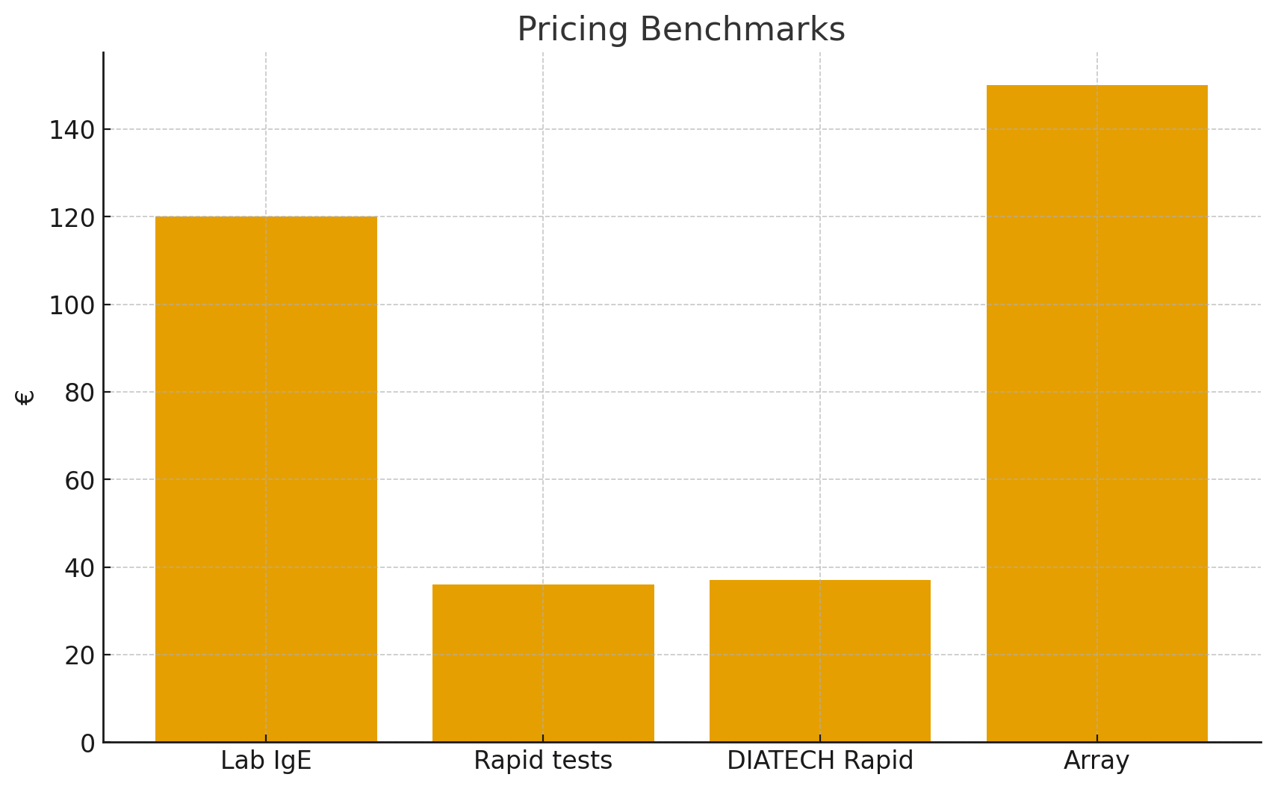
Pricing Benchmarks

Slide 3
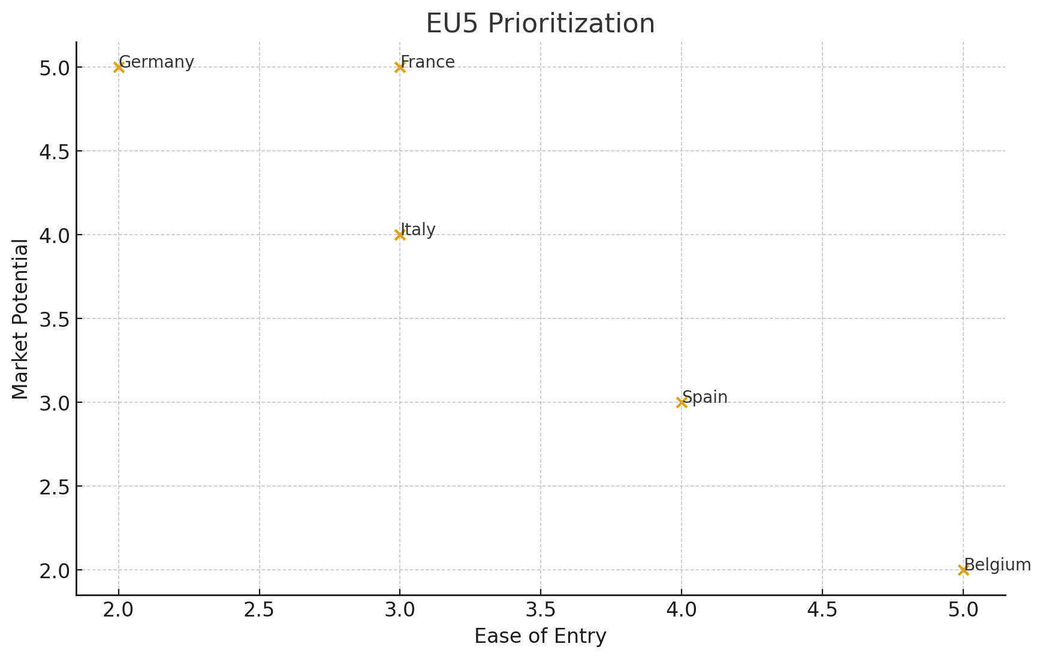
EU5 Market Prioritization

